Slide 1
AUTOMATED BUS SYSTEM
Submitted by,
SREELEKSHMI S
Roll.No:44

Slide 2
Abstract
This topic is an attempt to automate bus using the concept of line follower. The resultant system doesn’t require a driver for controlling the bus.
The bus uses image processing to detect bus stops and moves after pre alloted time.
It uses sound waves to detect obstruction and stops if it finds an obstruction nearby.

Slide 3
Driverless buses are poised to decongest personal traffic , shrink our eco footprint and reduce the frequency of collisions by about 90%.
Since it avoid the involvement of a driver, it reduces fare.
Presently, there is no such system for public transportation. Everyone is behind automating cars but still the frequency of traffic and accidents are not reduced as intended.
But, automating a public transport will help in this.

Slide 4
MOTIVATION
Now a days more accidents are reported due to over speed and ruthless driving.
Traffic congestion at busy roads makes the drivers prone to fatigue that results in lousy driving.
On the long run, automated system replacing the drivers are far more economically feasible.

Slide 5
Literature Survey
A wheeled robot is an autonomous robot and it can independently plan and manipulate its peculiar motion to facilitate the completion of particular tasks. It is controlled by various techniques.
There is a lot of research on control of the robot. The literature on the control of the robot is classified as
Control of mobile robots using Taguchi method
Control of mobile robots using Fuzzy logic controller

Slide 6
Control of mobile robots using a Neural Network controller
Control of line follower robots
Control of Cell phone operated robots
Control of Wall following robots

Slide 7
EXISTING SYSTEM
Manual Driving.
Traffic congestion.
Over speed and ruthless driving.

Slide 8
PROPOSED SYSTEM
This proposed system is used to automate the current bus system.
This system uses the concept of line follower. It doesn’t require a driver for controlling the bus.
This system uses two motors to control rear wheels and two motors for front wheels
It has infrared sensors on the bottom for detection of black tracking line.

Slide 9
This sensors detects the black colour and output is given to the comparator.
This system also detect any obstruction or any vehicles that comes in front of bus. This can be achieved using sonar technology. We will be using ultrasonic sensor to detect obstructions.
Also it detects bus stop signs using image processing and moves after pre allotted time.

Slide 10
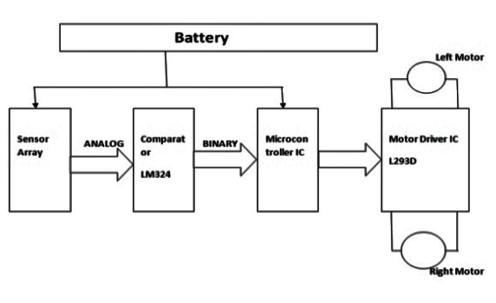
DESIGN

Slide 11
METHODOLOGY
Automated movement of bus
Bus line follower
Safety module
Stop sign
Integration

Slide 12
Automated movement of bus
This module involves building a basic prototype vehicle. For implementing the automated bus system.
Acrylic sheet for body
4 motor for control movement
Battery
Arduino is the main motherboard

Slide 13
Bus line follower
Developed countries like US have specific line for driving bus.
This module detects and make sure it stays inside the line.
This system involves the use of IR sensor set, complex mathematical functions like Fourier transformation and other mathematical functions.

Slide 14
Safety module
This module is used to detect any obstruction or any vehicles that comes in front of bus.
This can be achieved using sonar technology.
We will be using ultrasonic sensor to detect obstructions.

Slide 15
Stop sign
This module involves detecting bus stop signs using image processing.
It moves after pre allotted time.

Slide 16
Integration
It involves integrating image processing node with vehicle.
This can be achieved by using raspberry pi and ZERO W and pi camera

Slide 17
FUTURE SCOPE
As per knowledge, there are currently no existing system like ours is. Only robots using line followers are familiar, but no system is present like ours.

Slide 18
PROGRESS OF WORK
Complete the hardware part
Build a basic prototype vehicle

Slide 19
TIMELINE OF WORKS
March16
Sufficient dataset is provided to train the system
March 29
Preprocessed image is given as input to the system
April 17
Integrating image processing node with vehicle.

Slide 20
REFERENCE
Hasan, K.M. and Al Mamun, A., 2012, May. Implementation of autonomous line follower robot. In 2012 International Conference on Informatics, Electronics & Vision (ICIEV) (pp. 865-869). IEEE.
Kaiser, F., Islam, S., Imran, W., Khan, K.H. and Islam, K.M.A., 2014, April. Line follower robot: Fabrication and accuracy measurement by data acquisition. In 2014 International Conference on Electrical Engineering and Information & Communication Technology (pp. 1-6). IEEE.
Pakdaman, M., Sanaatiyan, M.M. and Ghahroudi, M.R., 2010, February. A line follower robot from design to implementation: Technical issues and problems. In 2010 The 2nd International Conference on Computer and Automation Engineering (ICCAE) (Vol. 1, pp. 5-9). IEEE.

Slide 21
THANK YOU

